Slide 1
Exploratory Data Analysis (EDA) Report
Understanding Employment and Educational Dynamics
By
Anusha Thandrapati

Slide 2
Introduction
The objective of this Exploratory Data Analysis (EDA) report is to analyze the provided dataset containing information about individuals' employment and educational background...
Through analysis, we aim to identify patterns, trends, and outliers within the dataset, ultimately aiming to provide actionable insights for stakeholders in human resources, education, and related fields.
Analyzing the provided dataset is crucial for understanding various aspects of workforce dynamics and educational trends.
It allows us to uncover hidden patterns, validate claims, and make evidence-based decisions, contributing to informed talent management and recruitment processes.

Slide 3
Dataset Overview
The dataset comprises rows and columns, with each row representing an individual and each column representing specific attributes such as ID, salary, date of joining (DOJ), etc.
Key Attributes:
Salary: Reflects the earnings of individuals.
Education: Includes percentages in 10th and 12th grades, college GPA, and specialization.
Professional: Encompasses job-related details such as designation, tenure, and skills scores.

Slide 4
Objective
The primary objective is to analyze and derive insights from the dataset to gain a better understanding of the factors influencing salary, job performance, and other relevant aspects for job candidates.
Through exploratory data analysis (EDA), we aim to identify patterns, correlations, and outliers within the dataset to facilitate informed decision-making in recruitment, talent management, and educational planning.

Slide 5
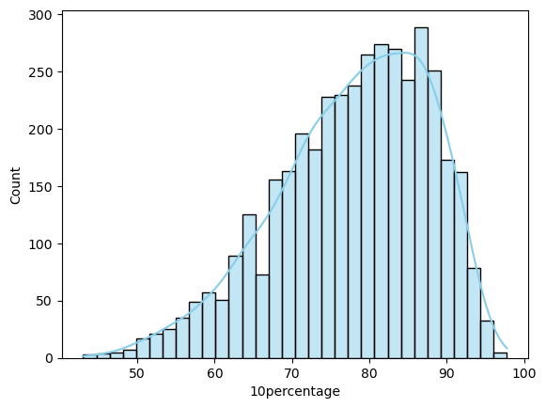
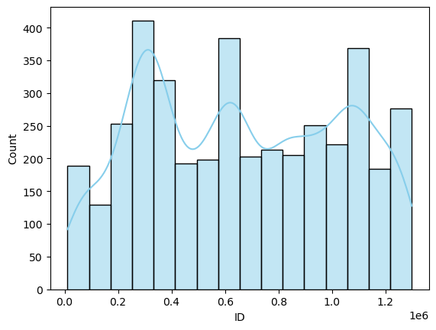
Univariate Analysis
Univariate analysis is a statistical method used to analyze and summarize data with a single variable
HISTPLOTS

Slide 6
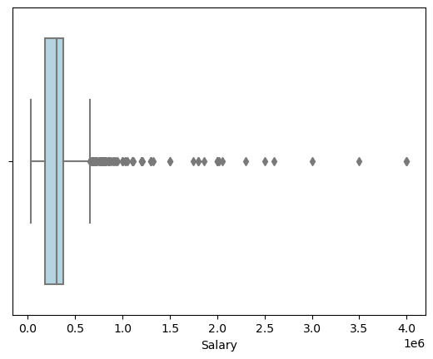
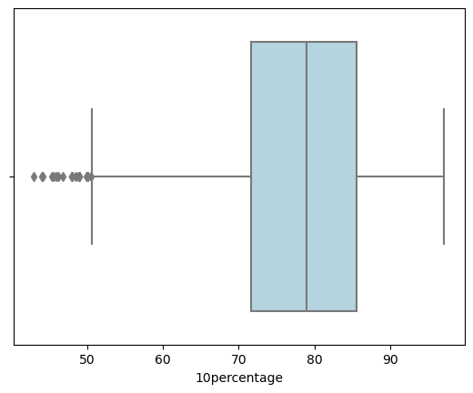
Univariate Analysis
BOXPLOTS

Slide 7
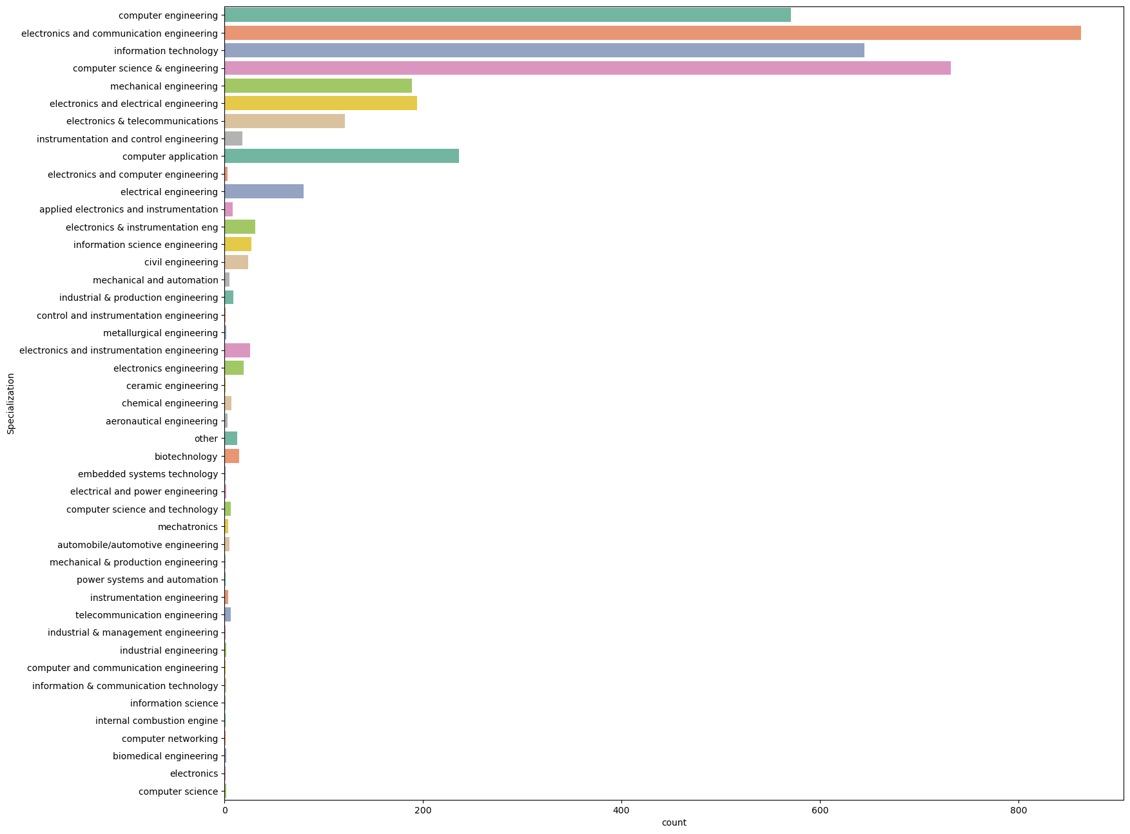
Univariate Analysis
COUNTPLOTS

Slide 8
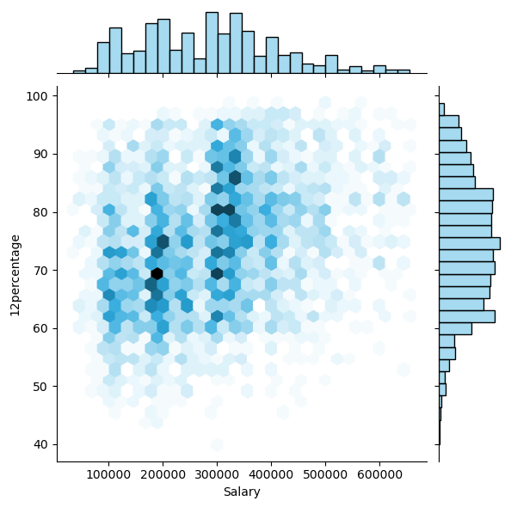
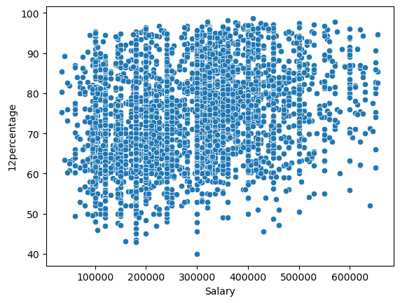
Bivariate Analysis
Bivariate analysis involves the simultaneous analysis of two variables to understand the relationships between them
SCATTER PLOTS

Slide 9
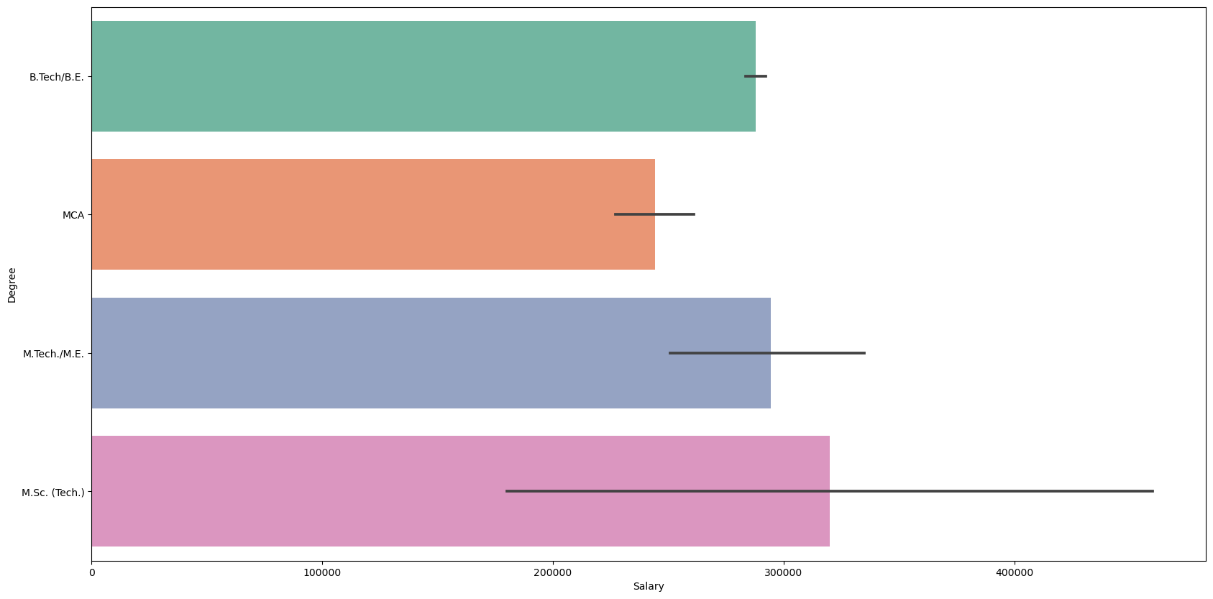
Bivariate Analysis
BARPLOT

Slide 10
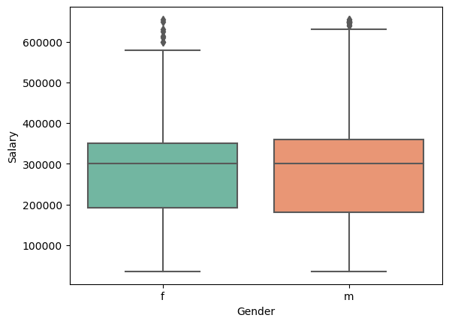
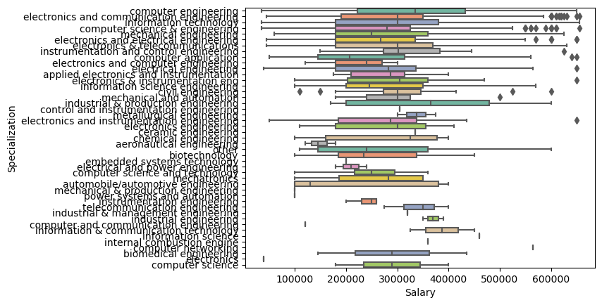
Bivariate Analysis
BOX PLOTS

Slide 11
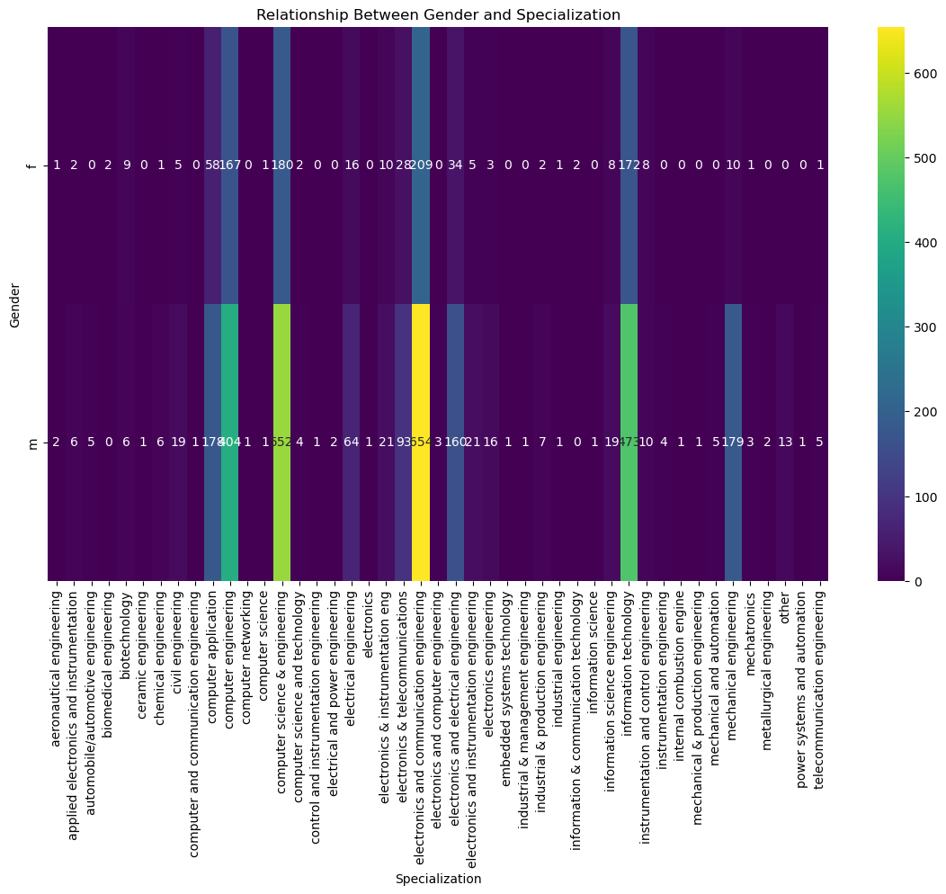
Research Findings
Summary of research findings derived from the analysis
Is there a relationship between gender and specialization?

Slide 12
Conclusion
In conclusion, this dataset offers a rich source of information about individuals' educational and professional backgrounds.
Insights Unveiled: The analysis has revealed valuable insights into individuals' educational and professional journeys, providing a nuanced understanding of workforce dynamics and academic achievements.
Actionable Directions: These insights offer actionable directions for optimizing recruitment processes, enhancing talent management strategies, and shaping educational programs to better align with industry needs.

Slide 13
THANK YOU
.

